Slide 1
US Holiday social posts
05/14/2026

Slide 2

Memorial Day
Post copy:
N/A

Slide 3
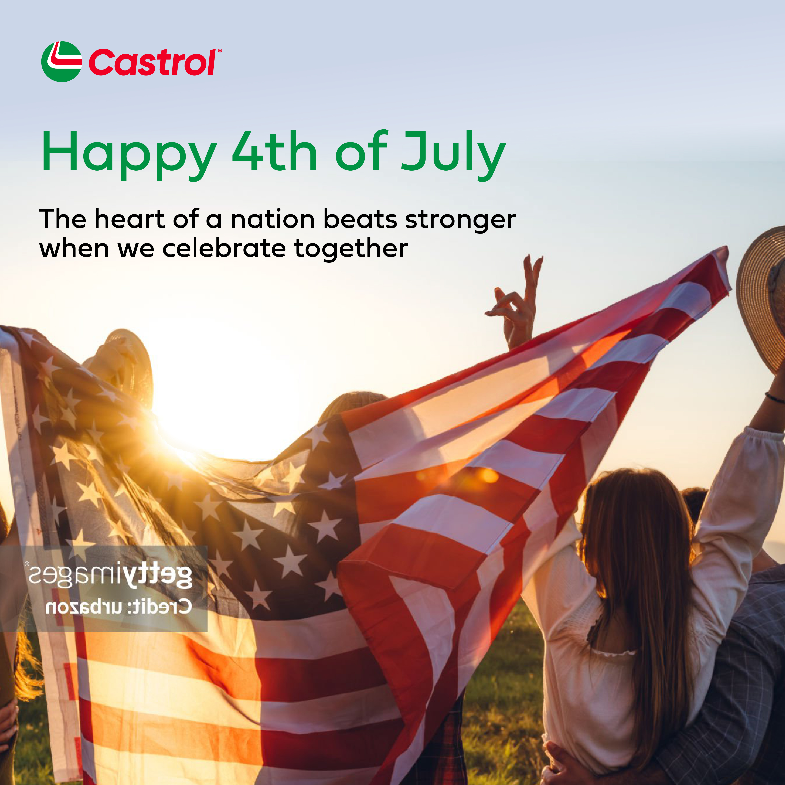
4th of July
Post copy:
Light up the sky with your people — @them here

Slide 4
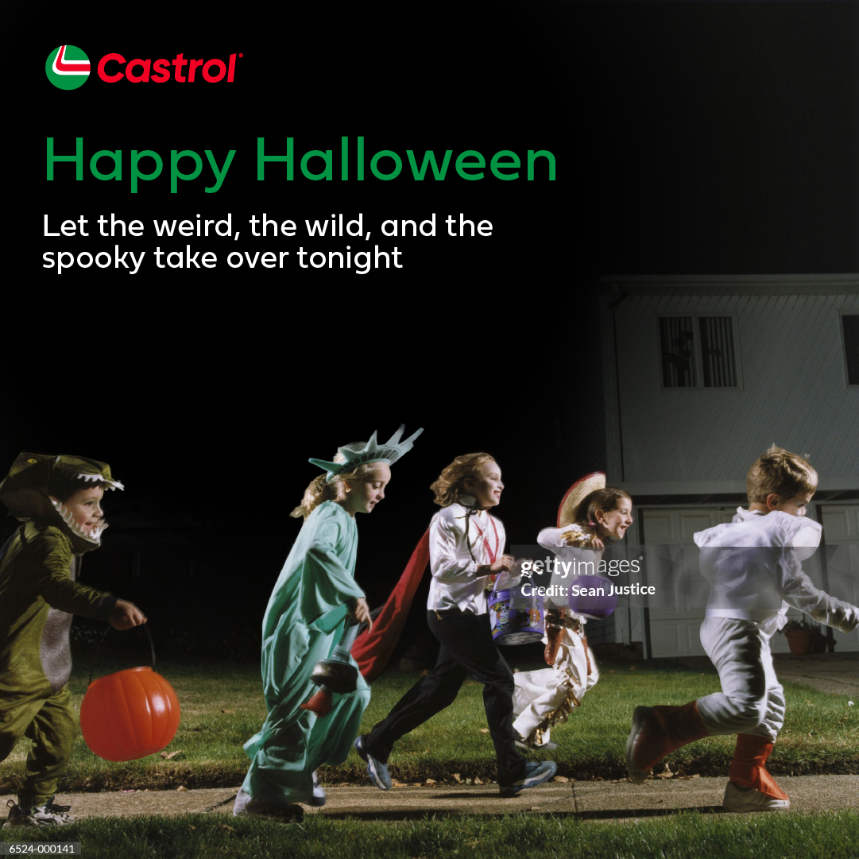
Halloween
Post copy:
We all know someone who goes all out — @them here

Slide 5

Thanksgiving
Post copy:
Who are you sharing your table with this year? @tag them here

Slide 6

Holidays
Post copy:
Your turn — @tag someone you're glad to have by your side, this and every season

Slide 7
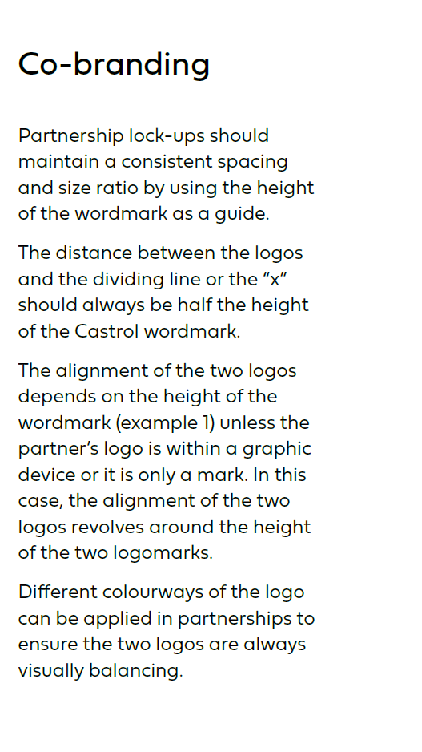

Logo placeholder guidelines
Place partner logo here
Partnership lock-up guidelines
Additional set of images provided, with vertical bar as logo divider

Slide 8
Thank you!

